Slide 1

SMART CLASSROOM
IoT-Based Motion,Temperature, Humidity and Noise Monitoring
ITEE
SUMMER PROGRAM

Slide 2
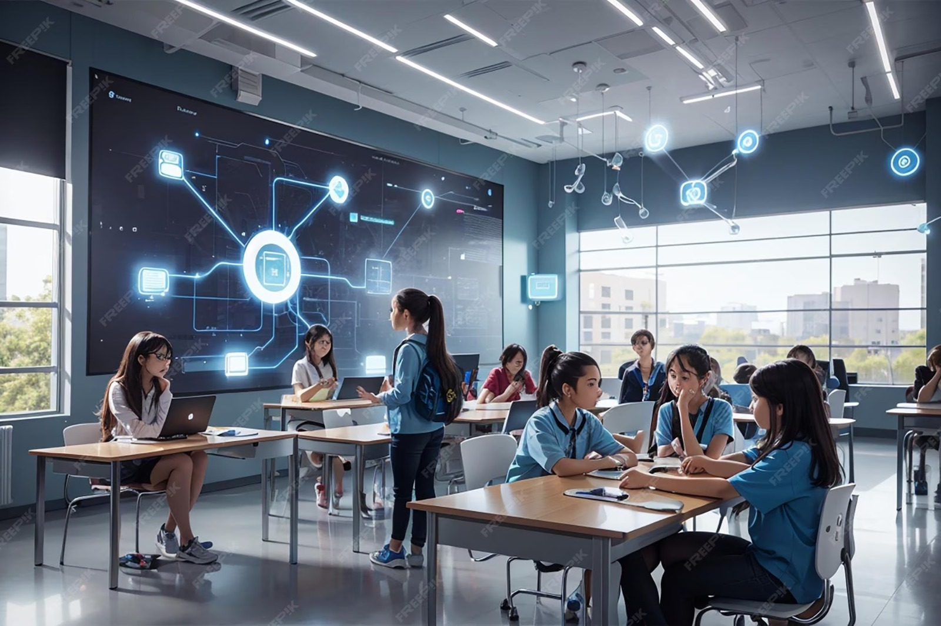

Contents
01
05
Introduction
Results
02
06
Problem Statement
Challenges and Future Works
03
07
Goals and Objectives
Conclusion
04
Tools and Methodology

Slide 3




Meet our Team
BRIAN KIBOR
WIRELESS COMMUNICATION
PRAKASH KARKEE
COMPUTER SCIENCE AND ENGINEERING
LIHINI KARUNARATHNE
COMPUTER SCIENCE AND ENGINEERING

Slide 4


Introduction
Classroom environments directly impact student focus, comfort, and learning outcomes.
Traditional classrooms lack automated monitoring of temperature, noise, and occupancy, making energy management and real-time supervision difficult.

Slide 5
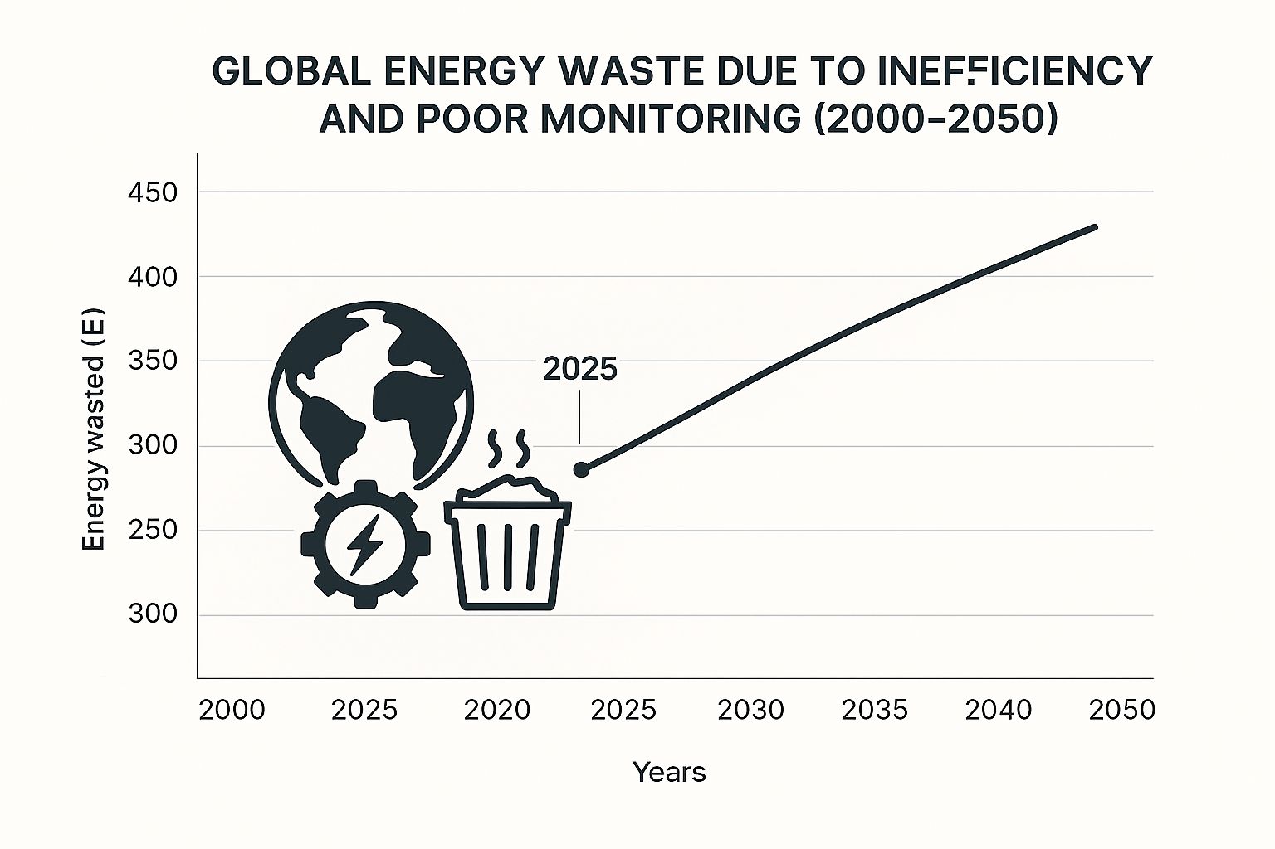

Status Quo?
30%
5% global GDP
Generated energy that goes to waste globally due to inefficient usage and monitoring.
Amount of student attention level reduced by noise levels above 65 dB in classrooms.
Notes:
400 exa Joules

Slide 6

Problem Statement

Slide 7
Problem Statement
Uncomfortable classroom environment (temperature & noise).
Energy wastage due to inefficient Lighting, AC and Heater use.
No centralized monitoring environmental conditions in real-time.
.

Slide 8

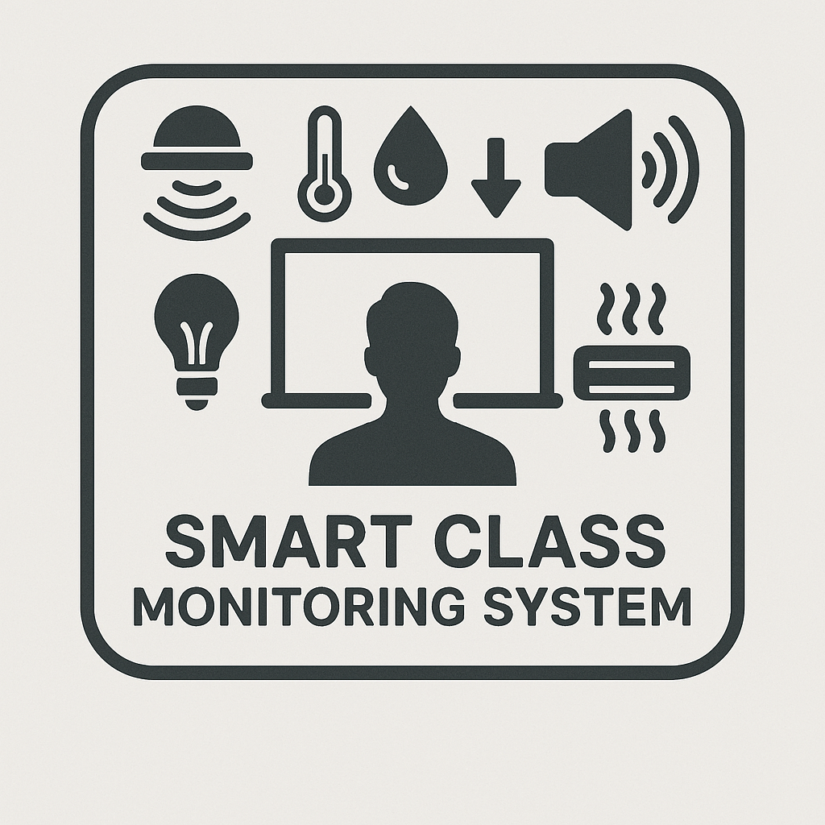


Goals and Objectives
Develop a real-time IoT monitoring system.
Automate classroom comfort and energy efficiency.
Enable cloud-based data logging and visualization.
Notes:
Collect classroom environmental data (temperature, humidity, motion, noise) using ESP32 and sensors.
Control AC and heater based on occupancy (motion) and temperature thresholds.
Push sensor data to Firebase and provide a dashboard for teachers/administrators to monitor conditions remotely.

Slide 9
ESP-32
ESP-32 Microcontroller for controlling the smart class room system.
Tools and Methodology
DHT11, PIR, I2S Microphone and LEDs
Sensors for collecting temperature, humidity, motion and noise levels in class room. LEDs for demonstrating Lighting, AC and Heater Control
Firebase and HMTL
Real time database for storing data and displaying historical statistics.

Slide 10

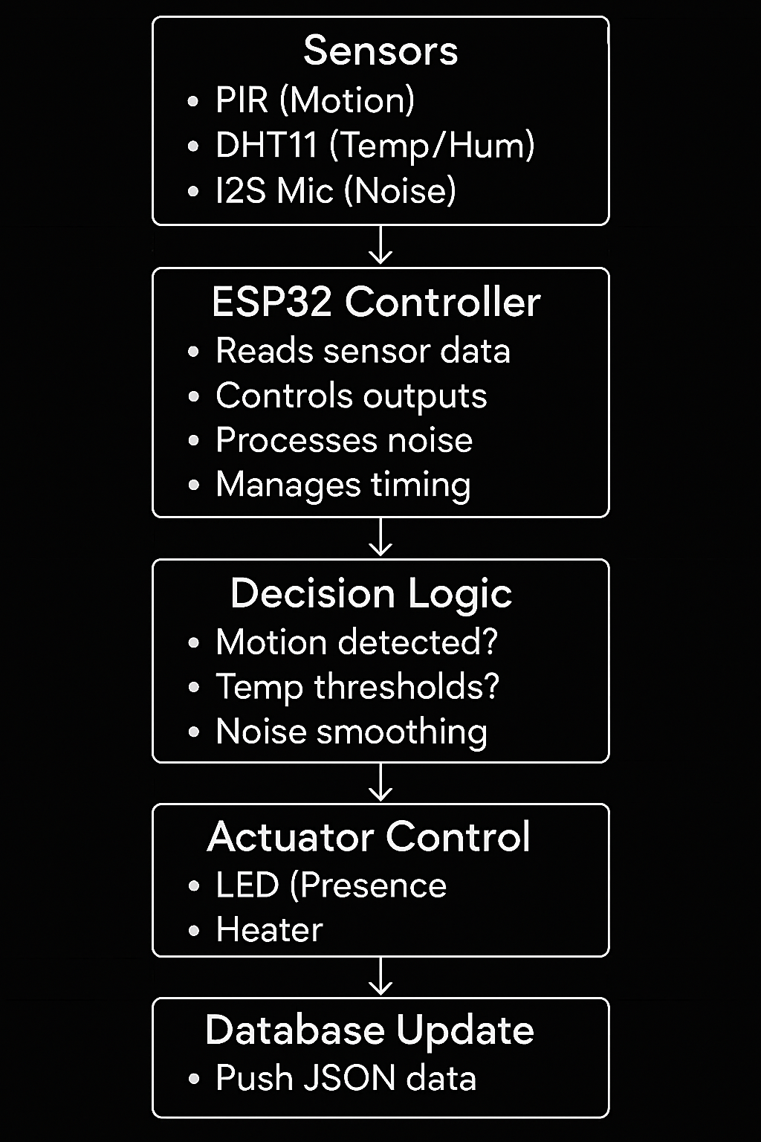
System Architecture

Slide 11
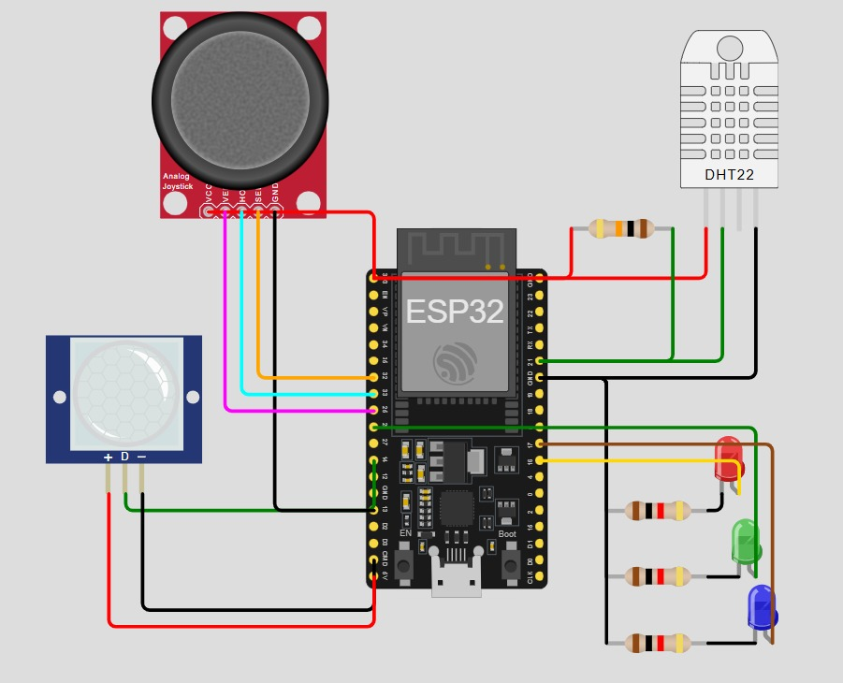
Circuit Diagram

Slide 12
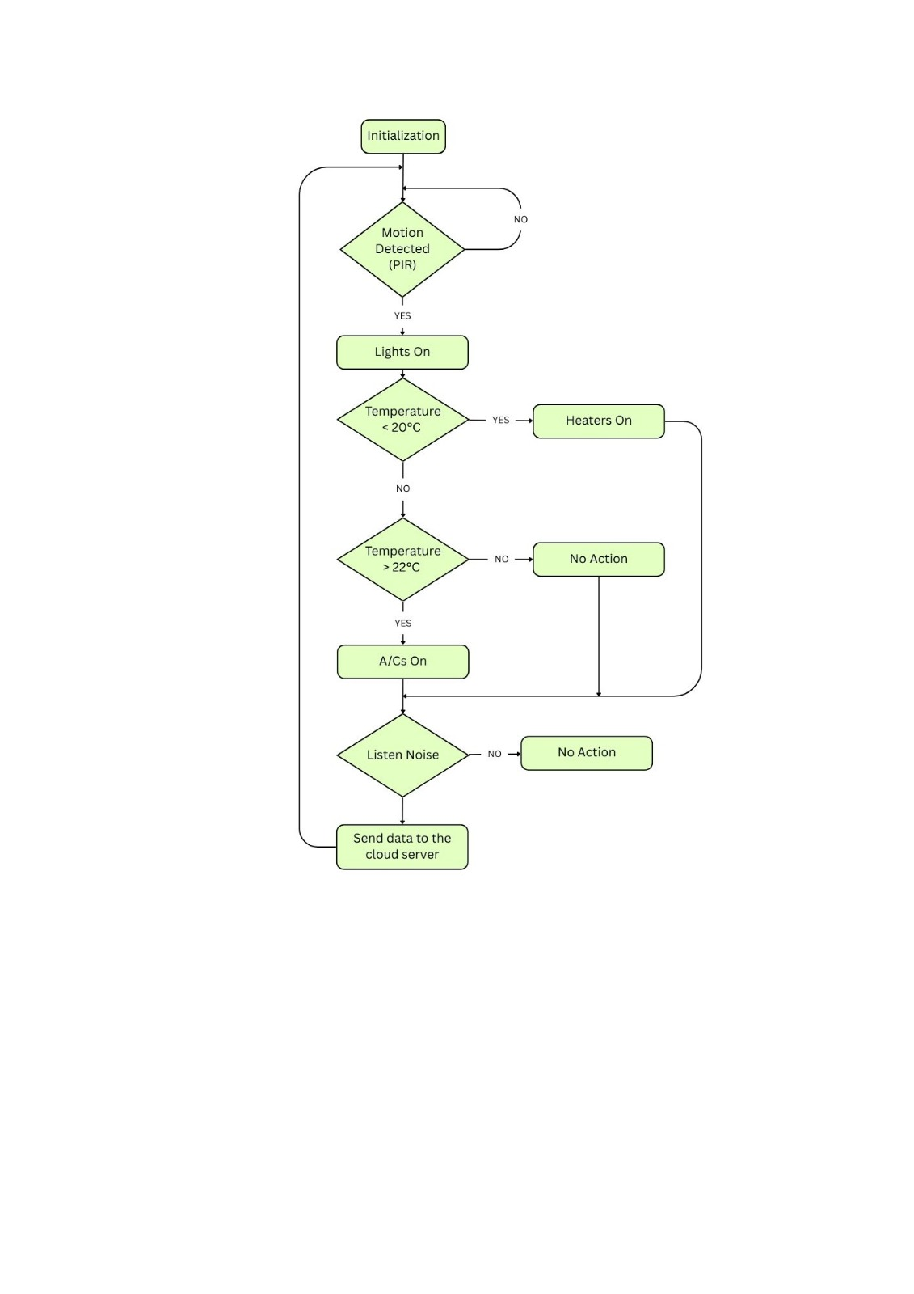
System Logic
System
Logic

Slide 13
Finding & Results
Automated AC/Heater control based on motion and temperature.
ESP32-based IoT system monitoring temp, humidity, motion, noise.
Firebase cloud logging for real-time dashboard.

Slide 14
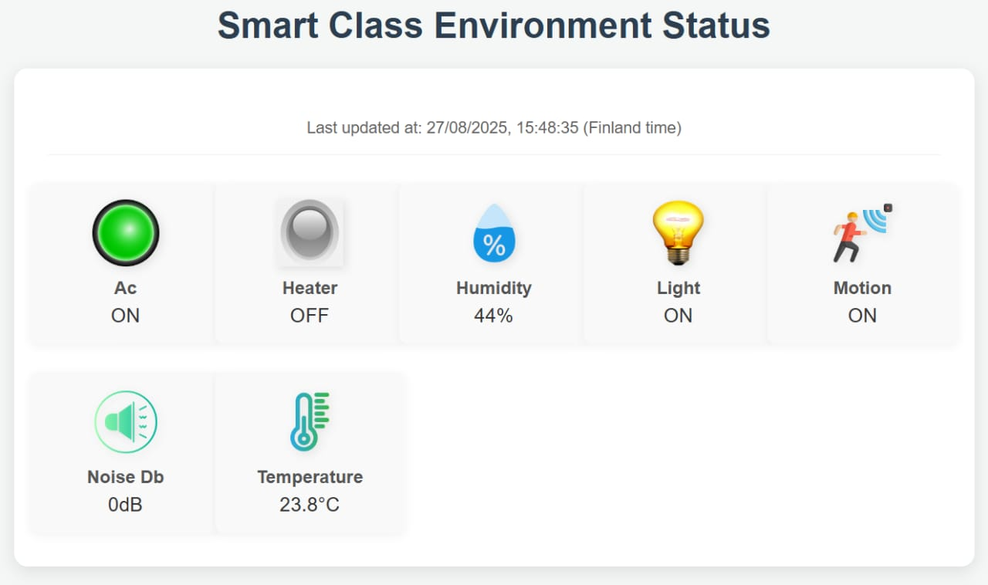
Smart Class Room
Play Video

Slide 15
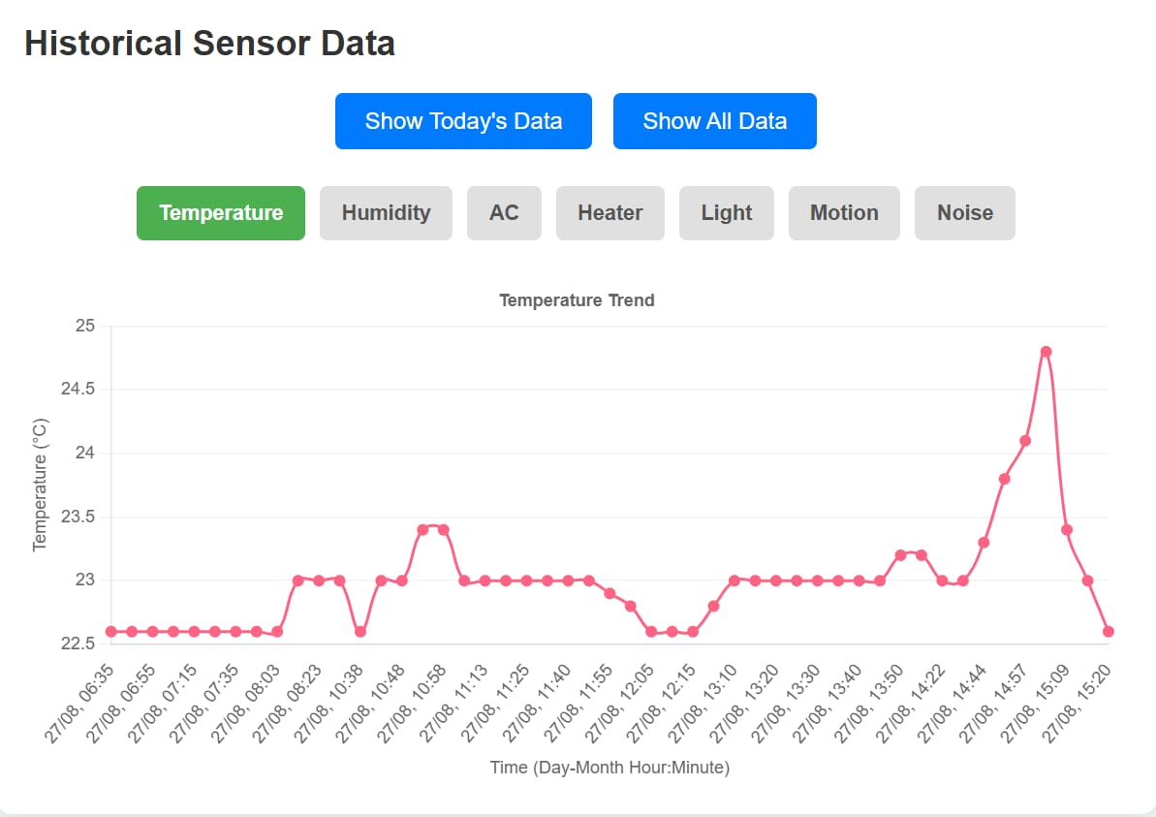
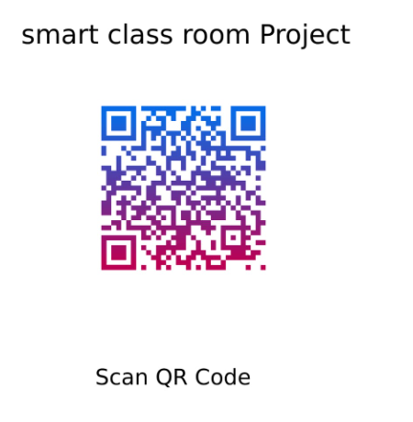
Smart Class Dashboard

Slide 16
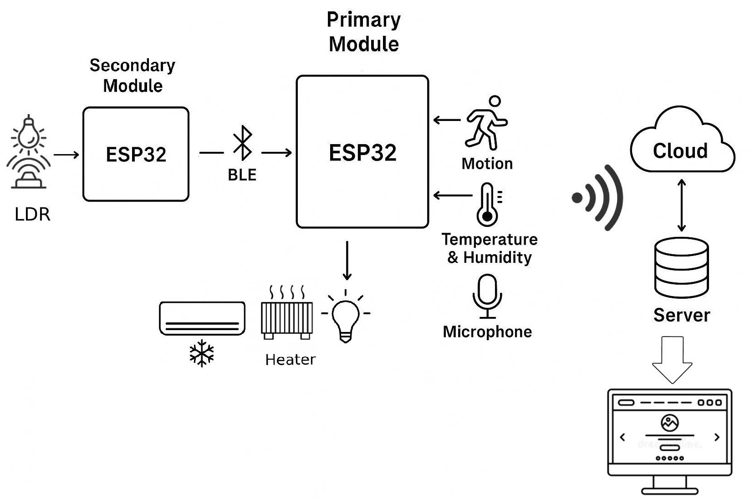
Challenges & Future Works
Insufficient memory limiting BLE integration
Integration of Teacher Notification
Machine Learning for voice activation

Slide 17

Conclusion
Wi-Fi connectivity, Firebase real-time database, motion detection, temperature and humidity sensing, AC and heater control, and noise level monitoring into a smart classroom system for improved monitoring and energy conservation.

Slide 18
Thank you
Any Questions?

